Slide 1

SAP BTP CAPM “TypeScript” for Developers
DAY-1
Anubhav Oberoy
www.AnubhavTrainings.com
Follow excellence with sheer passion

Slide 2


DISCLAIMER
The training content and delivery of this presentation is confidential, and cannot be recorded, or copied and distributed to any third party, without the written consent of Anubhav Trainings

Slide 3
Agenda
01
Who is this course for
02
Introduction to Type script
03
Interfaces, Types, Classes
04
Advance type script concepts
www.anubhavtrainings.com

Slide 4

This course is designed exclusively for SAP BTP developers who are already proficient in JavaScript, Node.js, the CAP framework, and the BTP platform. It covers only the TypeScript-specific knowledge and migration patterns needed to transition existing BTP projects from JavaScript to TypeScript — no platform orientation, no Node.js fundamentals, and no CAP architecture basics.
Introduction
Welcome to the BTP CAP Type Script training, The training is designed specifically for Fiori & CAP developers to migrate projects to Type Script
www.anubhavtrainings.com

Slide 5




Who is this course for
BTP Consultant
James- Embrace the change in the development paradigm using advance syntax of Type Script
CAP Developer
Ruhaan- Migrate your existing Java Script code to Type Script code along with best practices
Fiori Developer
Emayaa – Understand the syntax and changes which needs to be applied to logic to convert project to type script
Any SAP Consultant
Ronny – Embrace Type Script knowledge to implement type safe application development
www.anubhavtrainings.com

Slide 6

Course Outlook – 10 Hours
Type Script Basics for Transition
CI/CD pipeline & TypeScript-aware deployment
CAP in Type Script
SAP Cloud SDK & Fiori/UI5 in TypeScript
This module covers only the TypeScript concepts that do not exist in JavaScript.
It focuses entirely on what changes when moving an existing CAP JavaScript project to TypeScript.
This module covers the TypeScript-specific changes for two distinct areas: backend API consumption using the SAP Cloud SDK, and frontend Fiori/UI5 development
The final module covers the deployment pipeline changes needed to support TypeScript in an existing BTP project.
www.anubhavtrainings.com

Slide 7

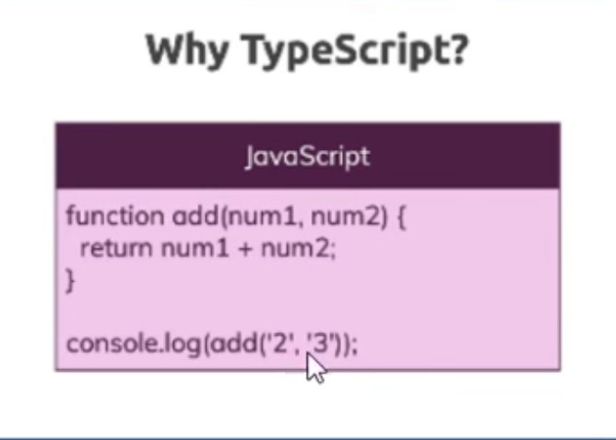
What is Type Script
Type Script is enhanced version of JS, TypeScript is a syntactic superset of JavaScript which adds static typing.
We could say its superset of JS
You can think like C++ is enhanced version of C
TypeScript is built upon Java Script only
TS = JS + Types, Like usually in JS we never provide data types while creating variables but in TS we must
Also TS offers better syntax to manage the classes and objects
TS cannot run directly in Browser, so it has to be converted to JS hence we have to write some special file or use modules to convert the TS to JS at runtime
TS Compiler converts the code from TS to JS
Benefits
We can do checks at compile time, So error handling is easy
Code Completion is better
Object Oriented programming can be added which offers classes, polymorphism, inheritance etc
Example when we define return type for the function @ design time which helps us to find compile time
History
Developed by Microsoft by enhancing JS
First released in Oct-2012 and influenced by JS
7
www.anubhavtrainings.com
7

Slide 8
Variable Creation
The most basic types in TypeScript are called primitives.
These types form the building blocks of more complex types in your applications.
TypeScript includes all JavaScript primitives plus additional type features.
Here are the five primitive types you'll use most often:
let varName : datatype = value;
let isActive: boolean = true; let hasPermission = false; // TypeScript infers 'boolean' type
let decimal: number = 6; let hex: number = 0xf00d; // Hexadecimal let binary: number = 0b1010; // Binary let octal: number = 0o744; // Octal let float: number = 3.14; // Floating point
let color: string = "blue"; let fullName: string = 'John Doe'; let age: number = 30; let sentence: string = `Hello, my name is ${fullName} and I'll be ${age + 1} next year.`;
7
www.anubhavtrainings.com
7

Slide 9
How to run TS code in VS Code/BAS
TypeScript is a superset of JavaScript that adds features such as data types, interfaces, classes, and compile-time error checking. Since browsers and Node.js understand JavaScript, TypeScript code must first be converted (compiled) into JavaScript before it can be executed. Visual Studio Code provides excellent support for TypeScript development, including syntax highlighting, IntelliSense, debugging, and terminal integration. To work with TypeScript, developers typically install Node.js, TypeScript, and optionally ts-node, which allows TypeScript files to be executed directly without manually compiling them.
TypeScript can be installed globally using npm. This provides access to the TypeScript Compiler (tsc) from any terminal window.
npm install -g typescript --Install TypeScript
tsc hello.ts --The TypeScript Compiler (tsc) converts .ts files into .js files that can be executed by Node.js.
node hello.js --Run the Generated JavaScript File:
Instead of compiling manually every time, developers often use ts-node, which compiles and executes TypeScript in a single step.
npm install -g ts-node
ts-node hello.ts
7
www.anubhavtrainings.com
7

Slide 10
Type Annotations and Inference
TypeScript offers two ways to work with types:
Explicit Typing: You explicitly declare the type of a variable
Type Inference: TypeScript automatically determines the type based on the assigned value
When to Use Each Approach
Use explicit types for:
Function parameters and return types
Object literals
When the initial value might not be the final type
Use type inference for:
Simple variable declarations with immediate assignment
When the type is obvious from the context
// String greeting: string = "Hello, TypeScript!"; // Number userCount: number = 42; // Boolean isLoading: boolean = true; // Array of numbers scores: number[] = [100, 95, 98];
// Function with explicit parameter and return types function greet(name: string): string { return `Hello, ${name}!`; } // TypeScript will ensure you pass the correct argument type greet("Alice"); // OK greet(42); // Error: Argument of type '42' is not assignable to parameter of type 'string'
7
www.anubhavtrainings.com
7

Slide 11
Special Types
The 'any' type allows you to opt-out of type checking for a variable. It can hold any value, and you can perform any operation on it without TypeScript raising an error.
The 'unknown' type is similar to 'any' in that it can hold any value, but it is safer because you cannot perform operations on it without first checking its type.
Working with arrays - let arrName: dataType[] = [];
Tuple, A tuple is a typed array with a pre-defined length and types for each index. Tuples are great because they allow each element in the array to be a known type of value.
Object - TypeScript has a specific syntax for typing objects.
Type Guard
A Type Guard in TypeScript is a technique used to check the type of a variable at runtime so that TypeScript can safely narrow the variable's type within a specific block of code.
7
www.anubhavtrainings.com
7

Slide 12
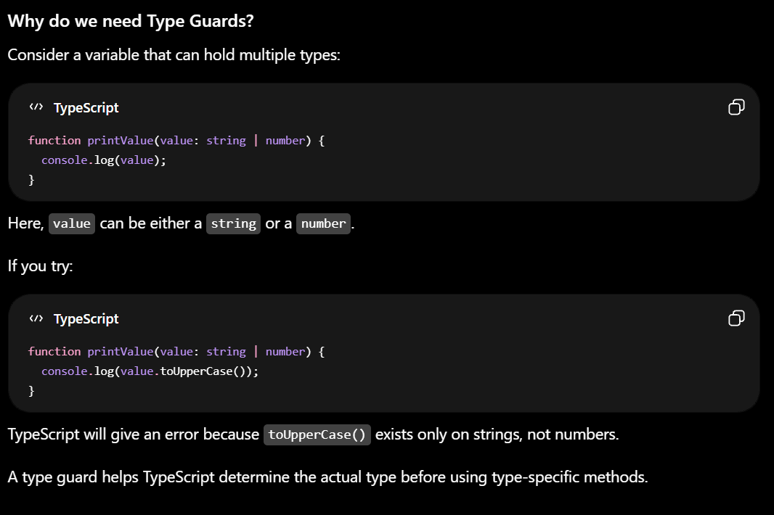
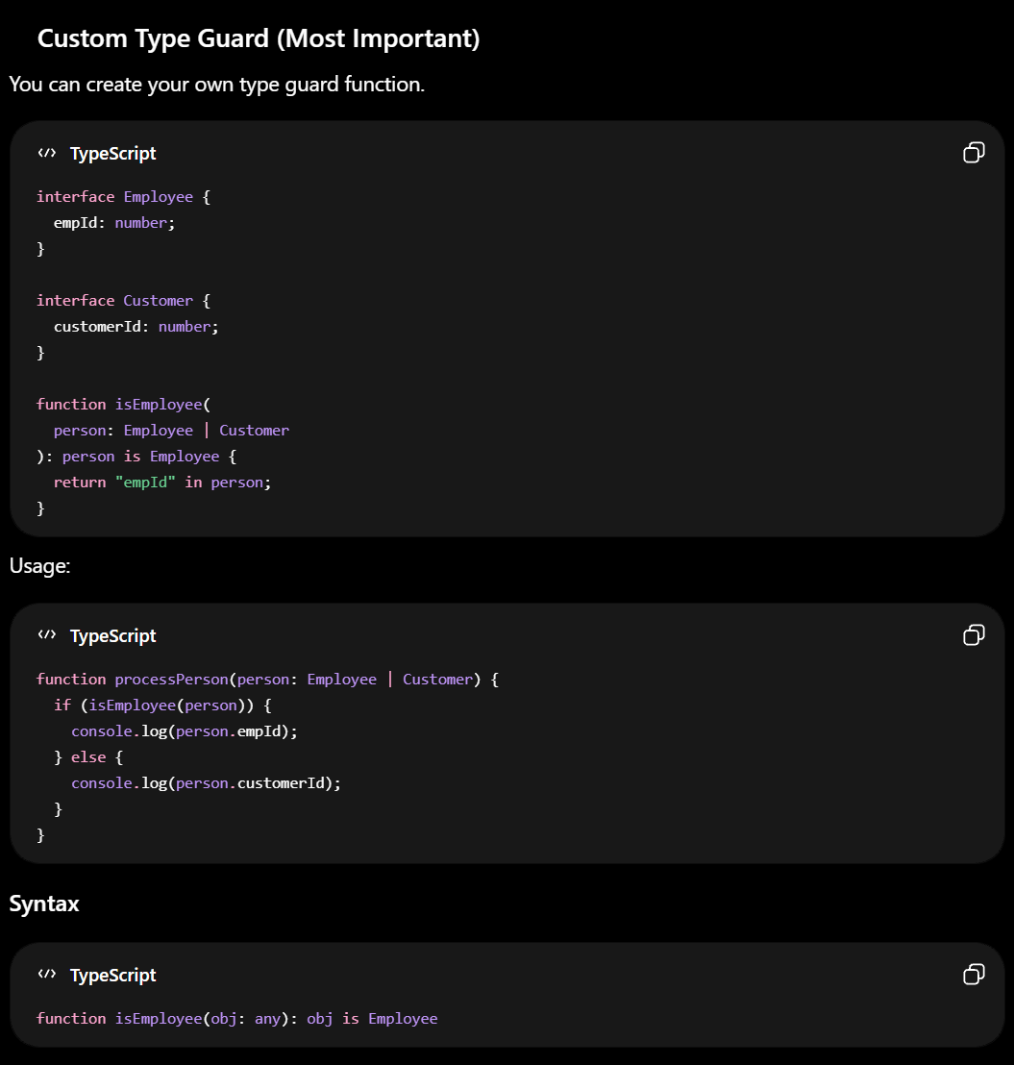
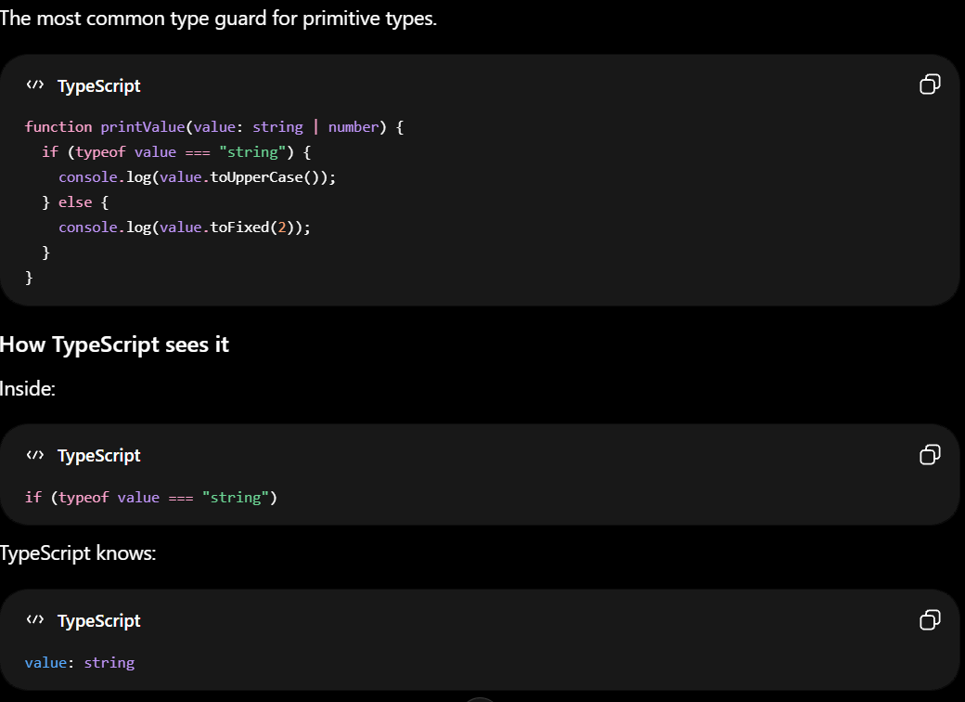
Type Guard
A Type Guard in TypeScript is a technique used to check the type of a variable at runtime so that TypeScript can safely narrow the variable's type within a specific block of code.
7
www.anubhavtrainings.com
7

Slide 13
TypeScript Type Aliases and Interfaces
Extending: Both can be extended, but interfaces support declaration merging.
Unions/Intersections: Only type aliases support union and intersection types.
Implements: Classes can implement either.
Recommendation: Use interface for objects, type for everything else.
Best Practices:
Use interface for defining object shapes and public APIs.
Use type for unions, intersections, and primitives.
Favor composition over inheritance for types.
Document your types and interfaces for clarity.
Common Pitfalls:
Using type when you need declaration merging (use interface).
Overcomplicating types-keep them simple and focused.
Forgetting to update types/interfaces as code evolves.
7
www.anubhavtrainings.com
7

Slide 14
TypeScript Definitely Typed
NPM packages in the broad JavaScript ecosystem don't always have types available.
Sometimes the projects are no longer maintained, and other times they aren't interested in, agree with, or have time to use TypeScript.
Using untyped NPM packages with TypeScript is not type-safe because types are missing.
To help TypeScript developers use such packages, there is a community-maintained project called Definitely Typed.
https://www.npmjs.com/package/@openui5/types
This npm package contains the TypeScript type definitions based on ES modules for all the OpenUI5 libraries.
These definitions can be used to:
Enable advanced content assist in IDEs, e.g: (VSCode / IntelliJ / Webstorm) for OpenUI5.
Integrate type checking for OpenUI5 applications using the TypeScript compiler.
These capabilities are available not only for OpenUI5 apps written in TypeScript, but to some degree also in JavaScript.
NOTE: "based on ES modules" means that the application code needs to load UI5 modules using the ES6 modules syntax and needs to be transformed to standard UI5 require/define syntax before it is executed. This is the recommended approach!
7
www.anubhavtrainings.com
7

Slide 15
TypeScript Configuration – tsconfig.json
The tsconfig.json file is the heart of every TypeScript project.
It tells the TypeScript compiler how to process your code, which files to include, and which features to enable or disable.
A well-configured tsconfig.json ensures a smooth developer experience and reliable builds.
compilerOptions: Controls how TypeScript compiles your code (e.g., target, module, strictness).
include: Files or folders to include in the compilation.
exclude: Files or folders to exclude.
files: Explicit list of files to include (rarely used with include).
extends: Inherit options from another config file.
references: Enable project references for monorepos or multi-package setups.
Use command tsc --init generate the tsconfig.json file
7
www.anubhavtrainings.com
7

Slide 16
Why Use TypeScript with Node.js?
TypeScript brings static typing to Node.js development, providing better tooling, improved code quality, and enhanced developer experience.
Key benefits include:
Type safety for JavaScript code
Better IDE support with autocompletion
Early error detection during development
Improved code maintainability and documentation
Easier refactoring
mkdir my-ts-node-app cd my-ts-node-app npm init -y npm install typescript @types/node --save-dev npx tsc –init
7
www.anubhavtrainings.com
7

Slide 17
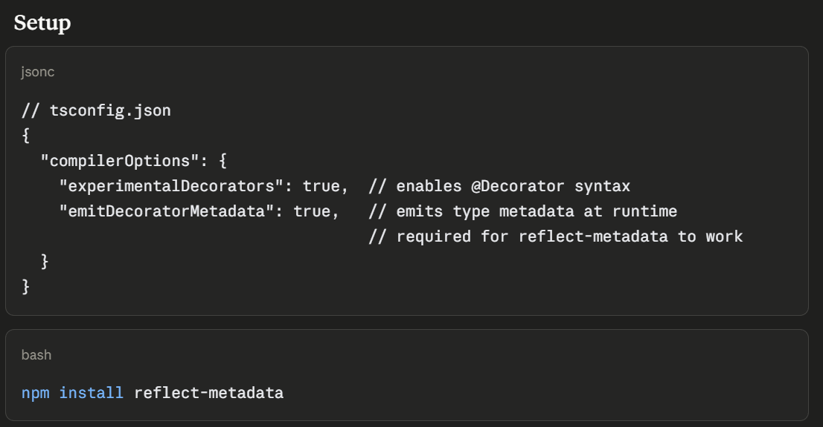
Decorators and Metadata reflection
Decorators are special functions prefixed with @ that attach to classes, methods, properties, or parameters and add behavior without modifying the original code — similar to Java Annotations or Python Decorators.
Metadata Reflection (reflect-metadata) lets decorators read/write hidden metadata about classes at runtime — used heavily by frameworks like NestJS, TypeORM.
7
www.anubhavtrainings.com
7

Slide 18
Utility types
Utility types are built-in generic types that transform existing types into new ones — no need to rewrite interfaces from scratch.
They're like type factories—you feed in a type, and out comes a new type with different properties.
Think of it like this: if you have a blueprint for a house, utility types let you create variations—a blueprint with fewer rooms, optional walls, readonly doors, etc.—without rewriting everything from scratch.
7
www.anubhavtrainings.com
7

Slide 19
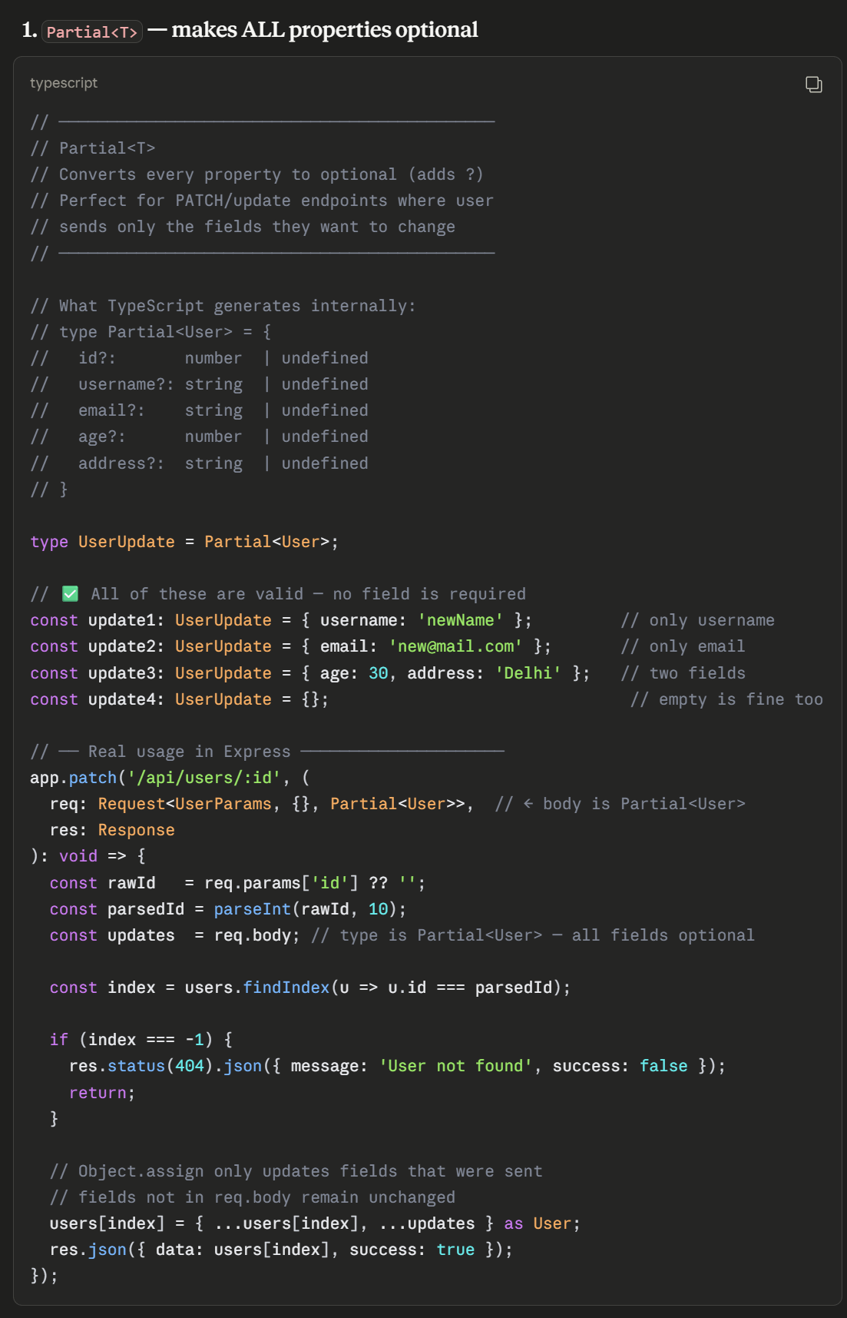
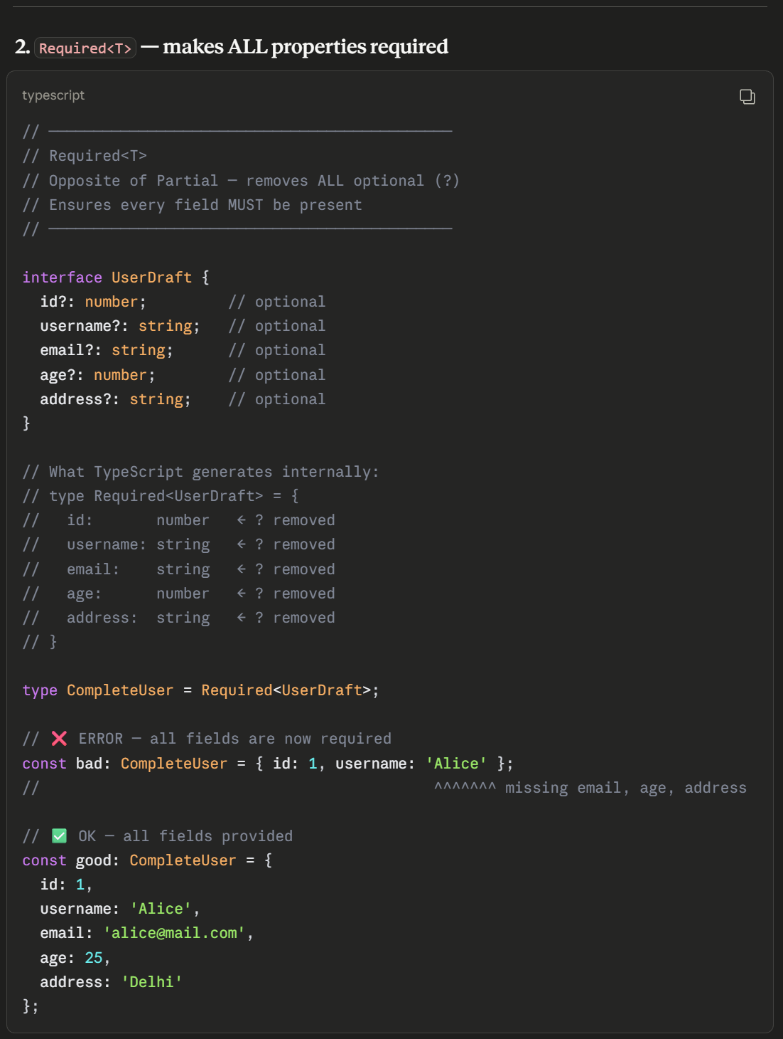
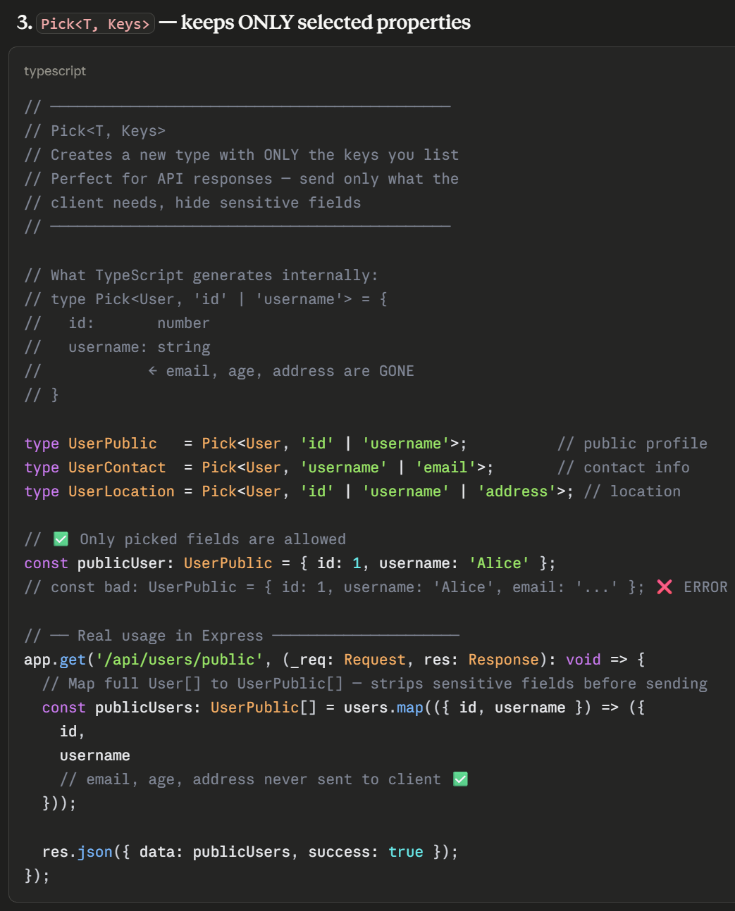
Partial, Required, Pick
Text
7
www.anubhavtrainings.com
7

Slide 20
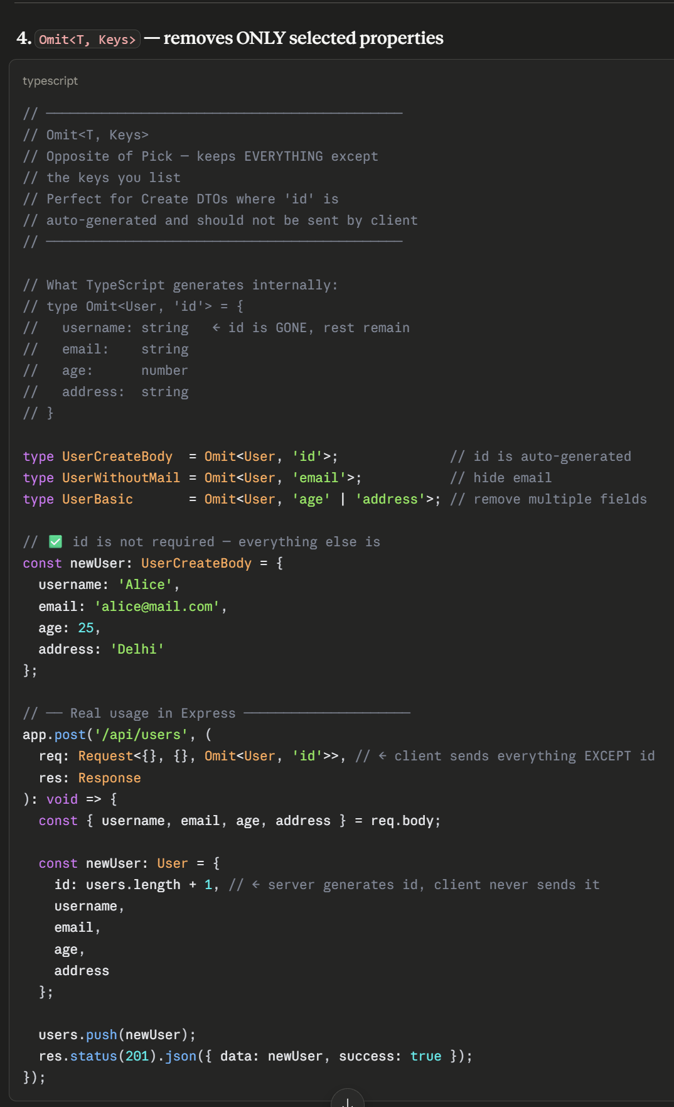
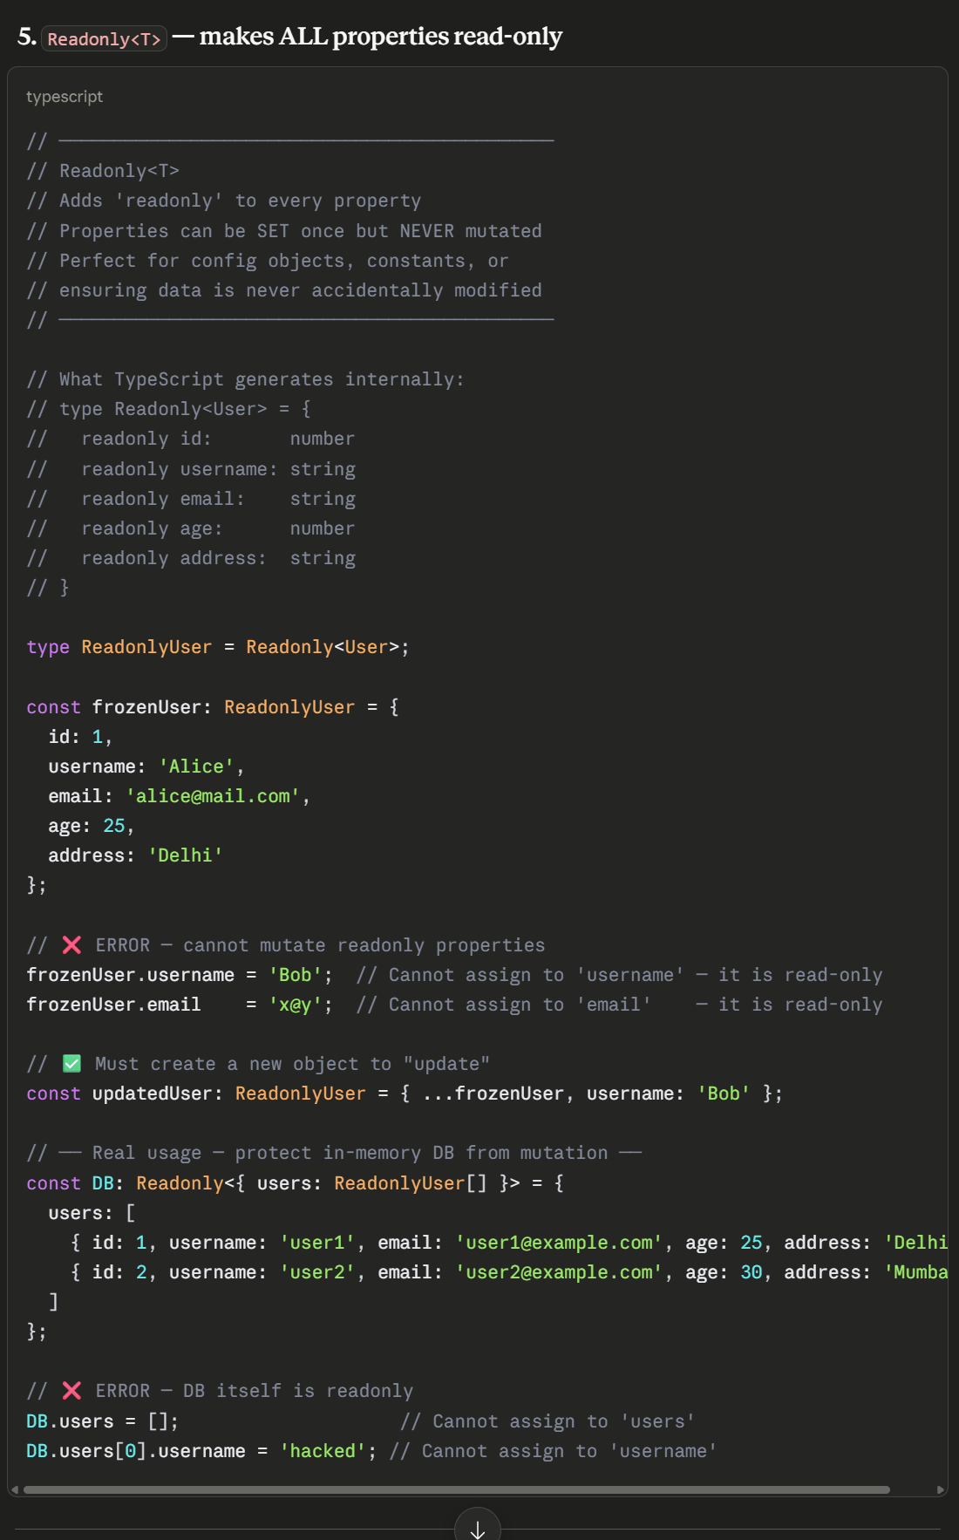
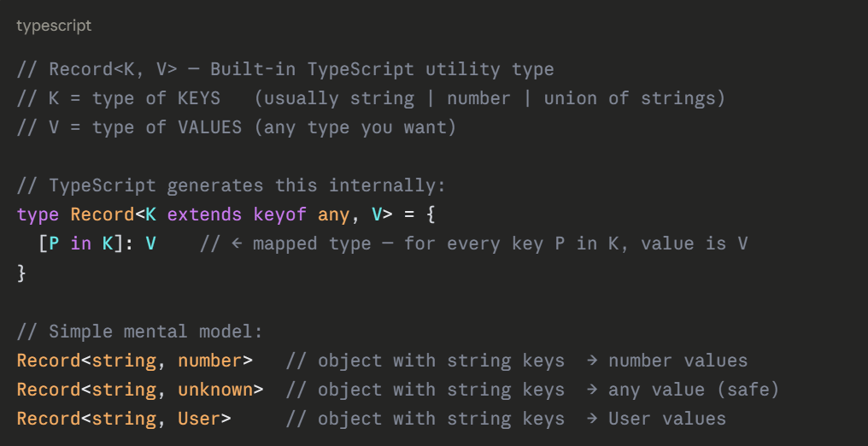
Omit and ReadOnly
7
www.anubhavtrainings.com
7

Slide 21
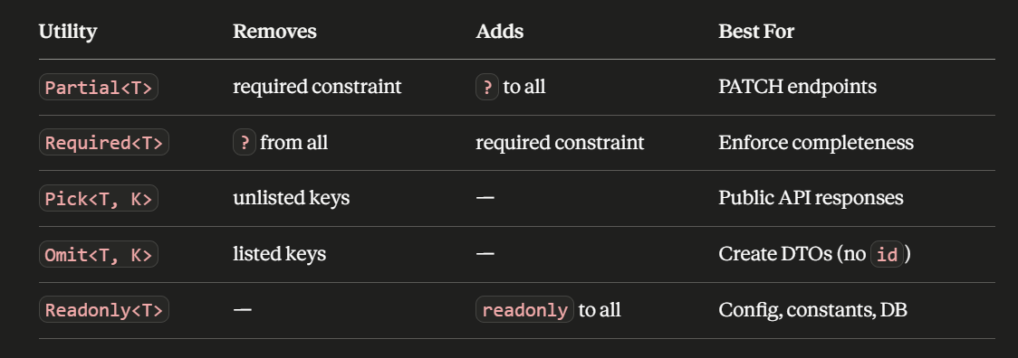
Summary
7
www.anubhavtrainings.com
7

Slide 22
Title
Text
7
www.anubhavtrainings.com
7

Slide 23
Title
Text
7
www.anubhavtrainings.com
7

Slide 24

What We Did
Let’s Summarize
www.anubhavtrainings.com

Slide 25
www.anubhavtrainings.com
Thank You
End of Day 1
www.anubhavtrainings.com

Slide 26


We’re committed to empower you to be
#FutureReady
through powerful training solutions.
We build the workforce of the future.
250+
Corporate Clients
30,000+
Learners Trained
25000+
Learners Placed
FREE WEBINARS
Sign up for free webinars with industry experts every fortnight!
Enroll Now!
Contact us today!
https://anubhavtrainings.com

